Slide 1

Task 4: Dashboard Design
Krishnendhu P A (Data Analyst Intern)

Slide 2
Project Objective
Objective: To design an interactive dashboard for business stakeholders to monitor and analyze call center sales performance.
Tool: Tableau was selected for its powerful and flexible data visualization capabilities.
Data: The analysis is based on a call center dataset, focusing on calls, agents, and product sales.
Goal: Provide actionable insights to inform business decisions, improve agent training, and increase sales efficiency.

Slide 3






Key Performance Indicators (KPIs)
Total Products Sold
Conversion Rate
Average Call Duration
The key efficiency metric. Calculated as (Total Sales / Total Calls Picked Up), this KPI measures how effectively an agent converts a call into a sale.
The primary volume metric. This tracks the total number of successful sales made by the team, providing a clear view of overall output.
A measure of operational performance. This tracks the average time spent on a call, helping identify trends in call handling and agent efficiency.

Slide 4
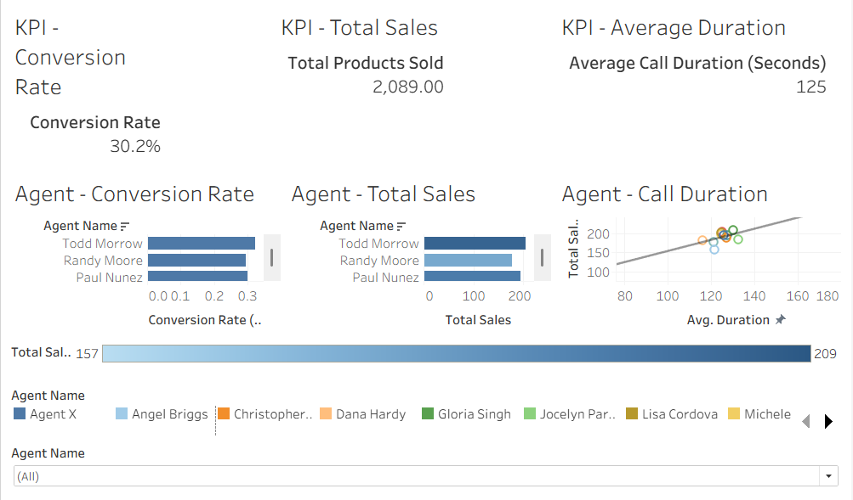
The Final Dashboard
Dashboard Overview
This is the central hub for our analysis. The dashboard provides a high-level overview of our main KPIs, tracks individual agent performance, and allows for deep-dive analysis in one unified view.
Stakeholders can use this tool to get instant answers on team performance and sales efficiency.

Slide 5
Insight: Top Performers
40%
Performance Concentration
The dashboard immediately reveals that sales performance is highly concentrated.
Of Sales from Top Agents
A small group of high-performing agents is responsible for a significant portion of all sales. This highlights a key opportunity for knowledge sharing from top performers to the rest of the team.

Slide 6


Insight: The Efficiency Gap
Observation: Volume
Opportunity: Efficiency
The dashboard shows that some agents with the highest *volume* of sales do not necessarily have the highest *conversion rates*. They achieve their numbers through a high volume of calls.
Other agents have much higher conversion rates, securing more sales with fewer calls. We can analyze their techniques (e.g., call scripts, handling objections) to create a best-practice model for team-wide training.

Slide 7
Insight: Call Duration Analysis
Call quality and agent skill are more important than call length.
"
"
— Key Finding from Duration vs. Sales Analysis
The scatter plot analysis shows no strong correlation between *longer* calls and *more* sales. Many successful sales occur at or below the average call duration, suggesting that efficiency is key.

Slide 8
Interactive Dashboard Features
Agent Filter: The "Agent Name" filter allows stakeholders to dynamically select one or more agents, causing all charts and KPIs to update instantly.
Cross-Filtering Actions: Clicking an agent's name on any chart (e.g., "Top Sales Performers") will filter the *entire dashboard* to that specific agent.
Detailed Tooltips: Hovering over any data point provides a detailed tooltip with specific numbers for Sales, Conversion Rate, and Call Duration for that agent.

Slide 9
Thank You

